Slide 1
Diabetic retinopathy is an eye condition that can cause vision loss and blindness in people who have diabetes. Diabetic retinopathy is best diagnosed with a comprehensive dilated eye exam.
Introduction Khavieya

Slide 2
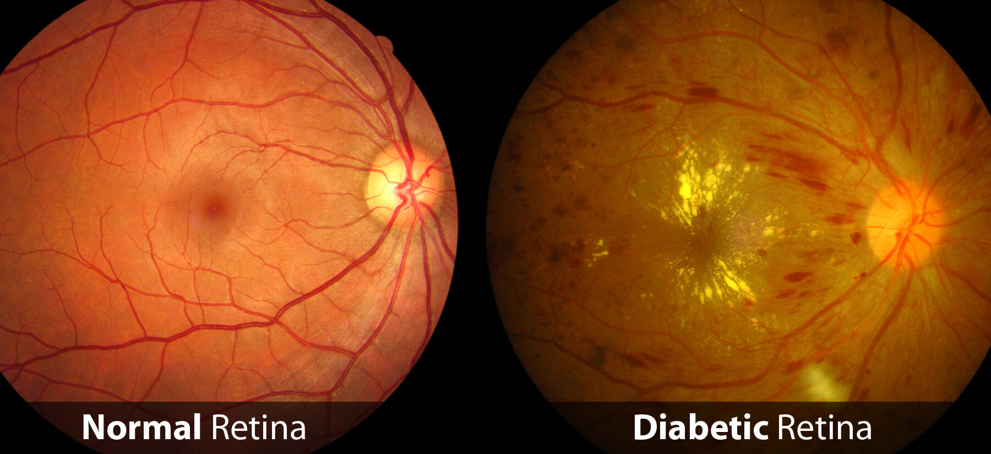
Normal Vision and Diabetic Vision

Slide 3
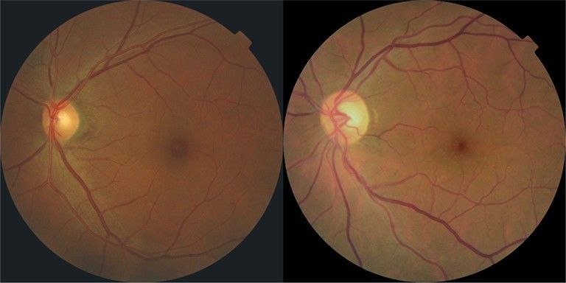
Analsyis Approach
Machine Learning
Deep Learning

Slide 4
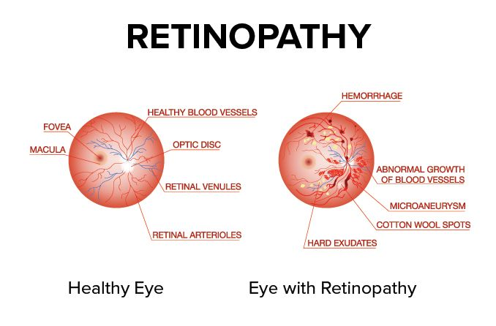
Diabetic retinopathy is caused by high blood sugar due to diabetes.
Diabetic retinopathy can cause abnormal blood vessels to grow out of the retina and block fluid from draining out of the eye. This causes a type of glaucoma (a group of eye diseases that can cause vision loss and blindness).

Slide 5
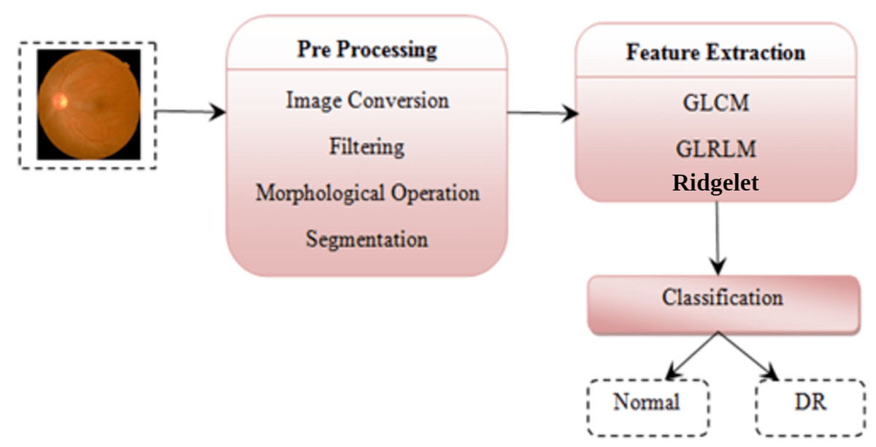
Building an ML model
Ideal Machine learning Flowchart

Slide 6
Work carried out
Gather datasets
Build a Deep learning model

Slide 7
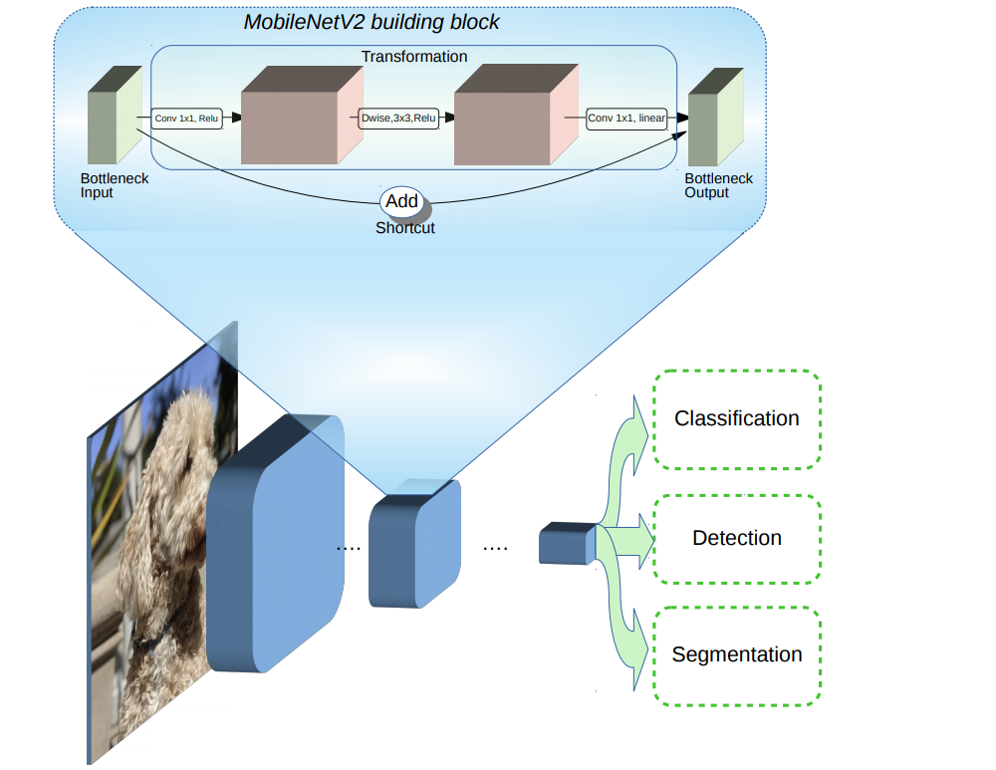
Sample Mobilenet V2 Architecture

Slide 8
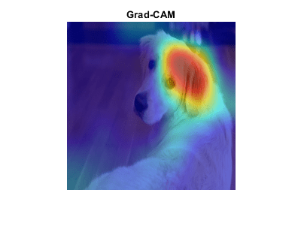
What is Grad-CAM?
Grad-CAM is a generalization of the class activation mapping (CAM) technique. For activation mapping techniques on live webcam data, see Investigate Network Predictions Using Class Activation Mapping. Grad-CAM can also be applied to nonclassification examples such as regression or semantic segmentation.

Slide 9
ML APPROCH
MobilenetV2 Architecture
Pull in Dataset
GradCAM Score Add
Accuracy calculation value

Slide 10
Work carried out
Input Images 103
Model trained using 450 images
Accuarcy obtained > 65%

Slide 11
Thank You

